Slide 1
Exploring Your Journey Through Art
Jenny Ning Zhan

Slide 2
Master Research Project: Inquiry into MU International Student Identity

Slide 3
Notes:
Icebreaker game
Have participants randomly choose the paper and answer the question.

Slide 4
Overview
In this meeting, you are going to explore your life journey through art. You would appreciate and discuss some artists who explore the idea of “journey” and you then are asked to make your maps of journey by drawing or using collage method. Finally, you will share you maps and thought to the group and the rest of you could examine whether your views are close to the presenters.

Slide 5
How do artists explore their life journey and how do you get inspired from them?
Notes:
Before seeing some artists’ works, here are some questions for you to reflect on.

Slide 6
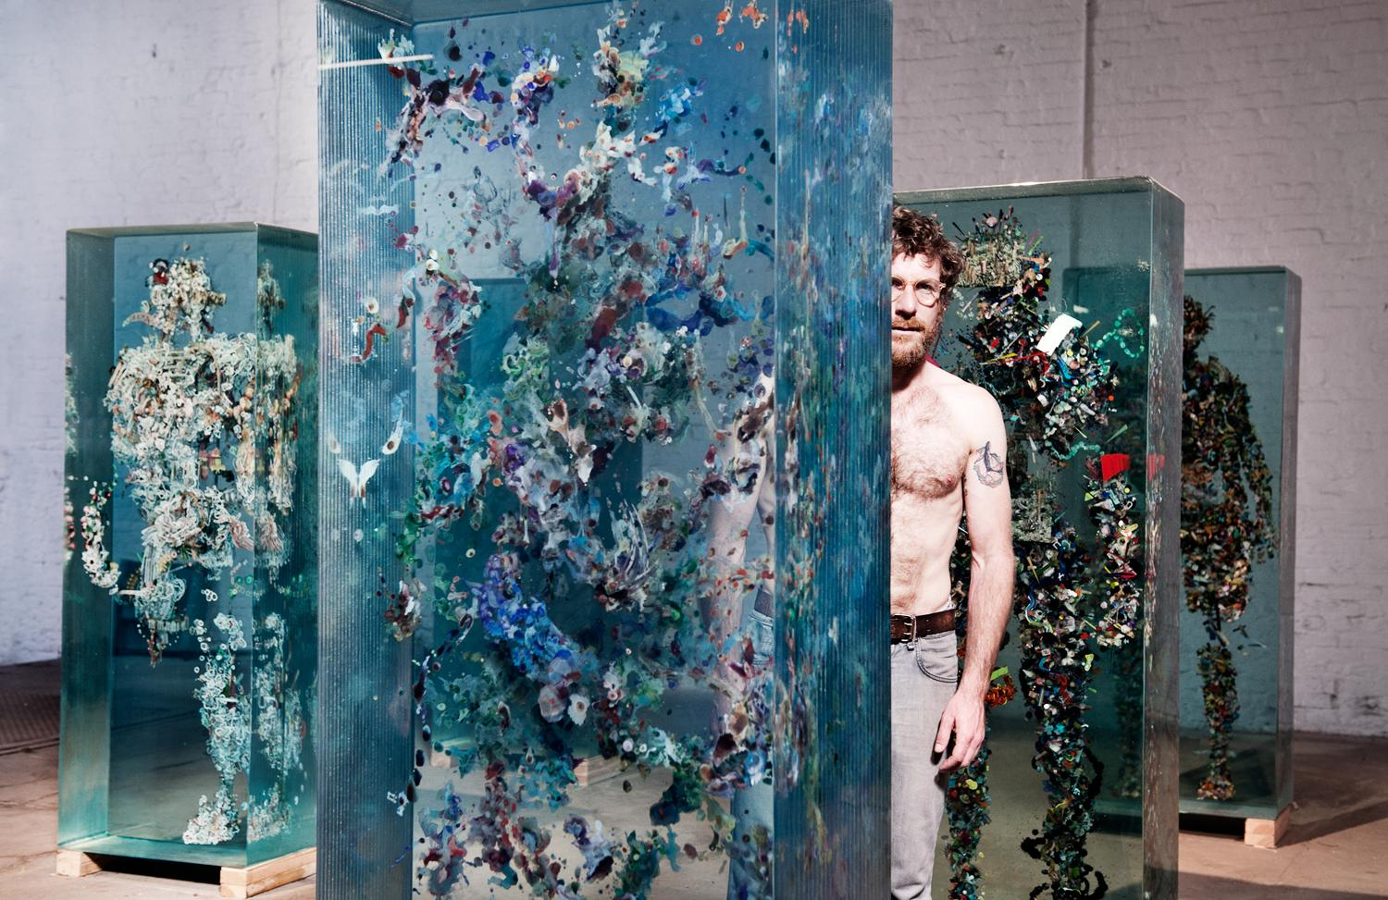
A Journey Through the Mind of An Artist
Dustin Yellin makes mesmerizing artwork that tells complex, myth-inspired stories. How did he develop his style? In this disarming talk, he shares the journey of an artist -- starting from age 8 -- and his idiosyncratic way of thinking and seeing. Follow the path that leads him up to his latest major work (or two).
https://www.ted.com/talks/dustin_yellin_a_journey_through_the_mind_of_an_artist#t-438874

Slide 7
A Journey to MU Art Education By Jenny
https://www.youtube.com/watch?v=cI_m9hd2q24
Notes:
Share my visual journey map with participants

Slide 8
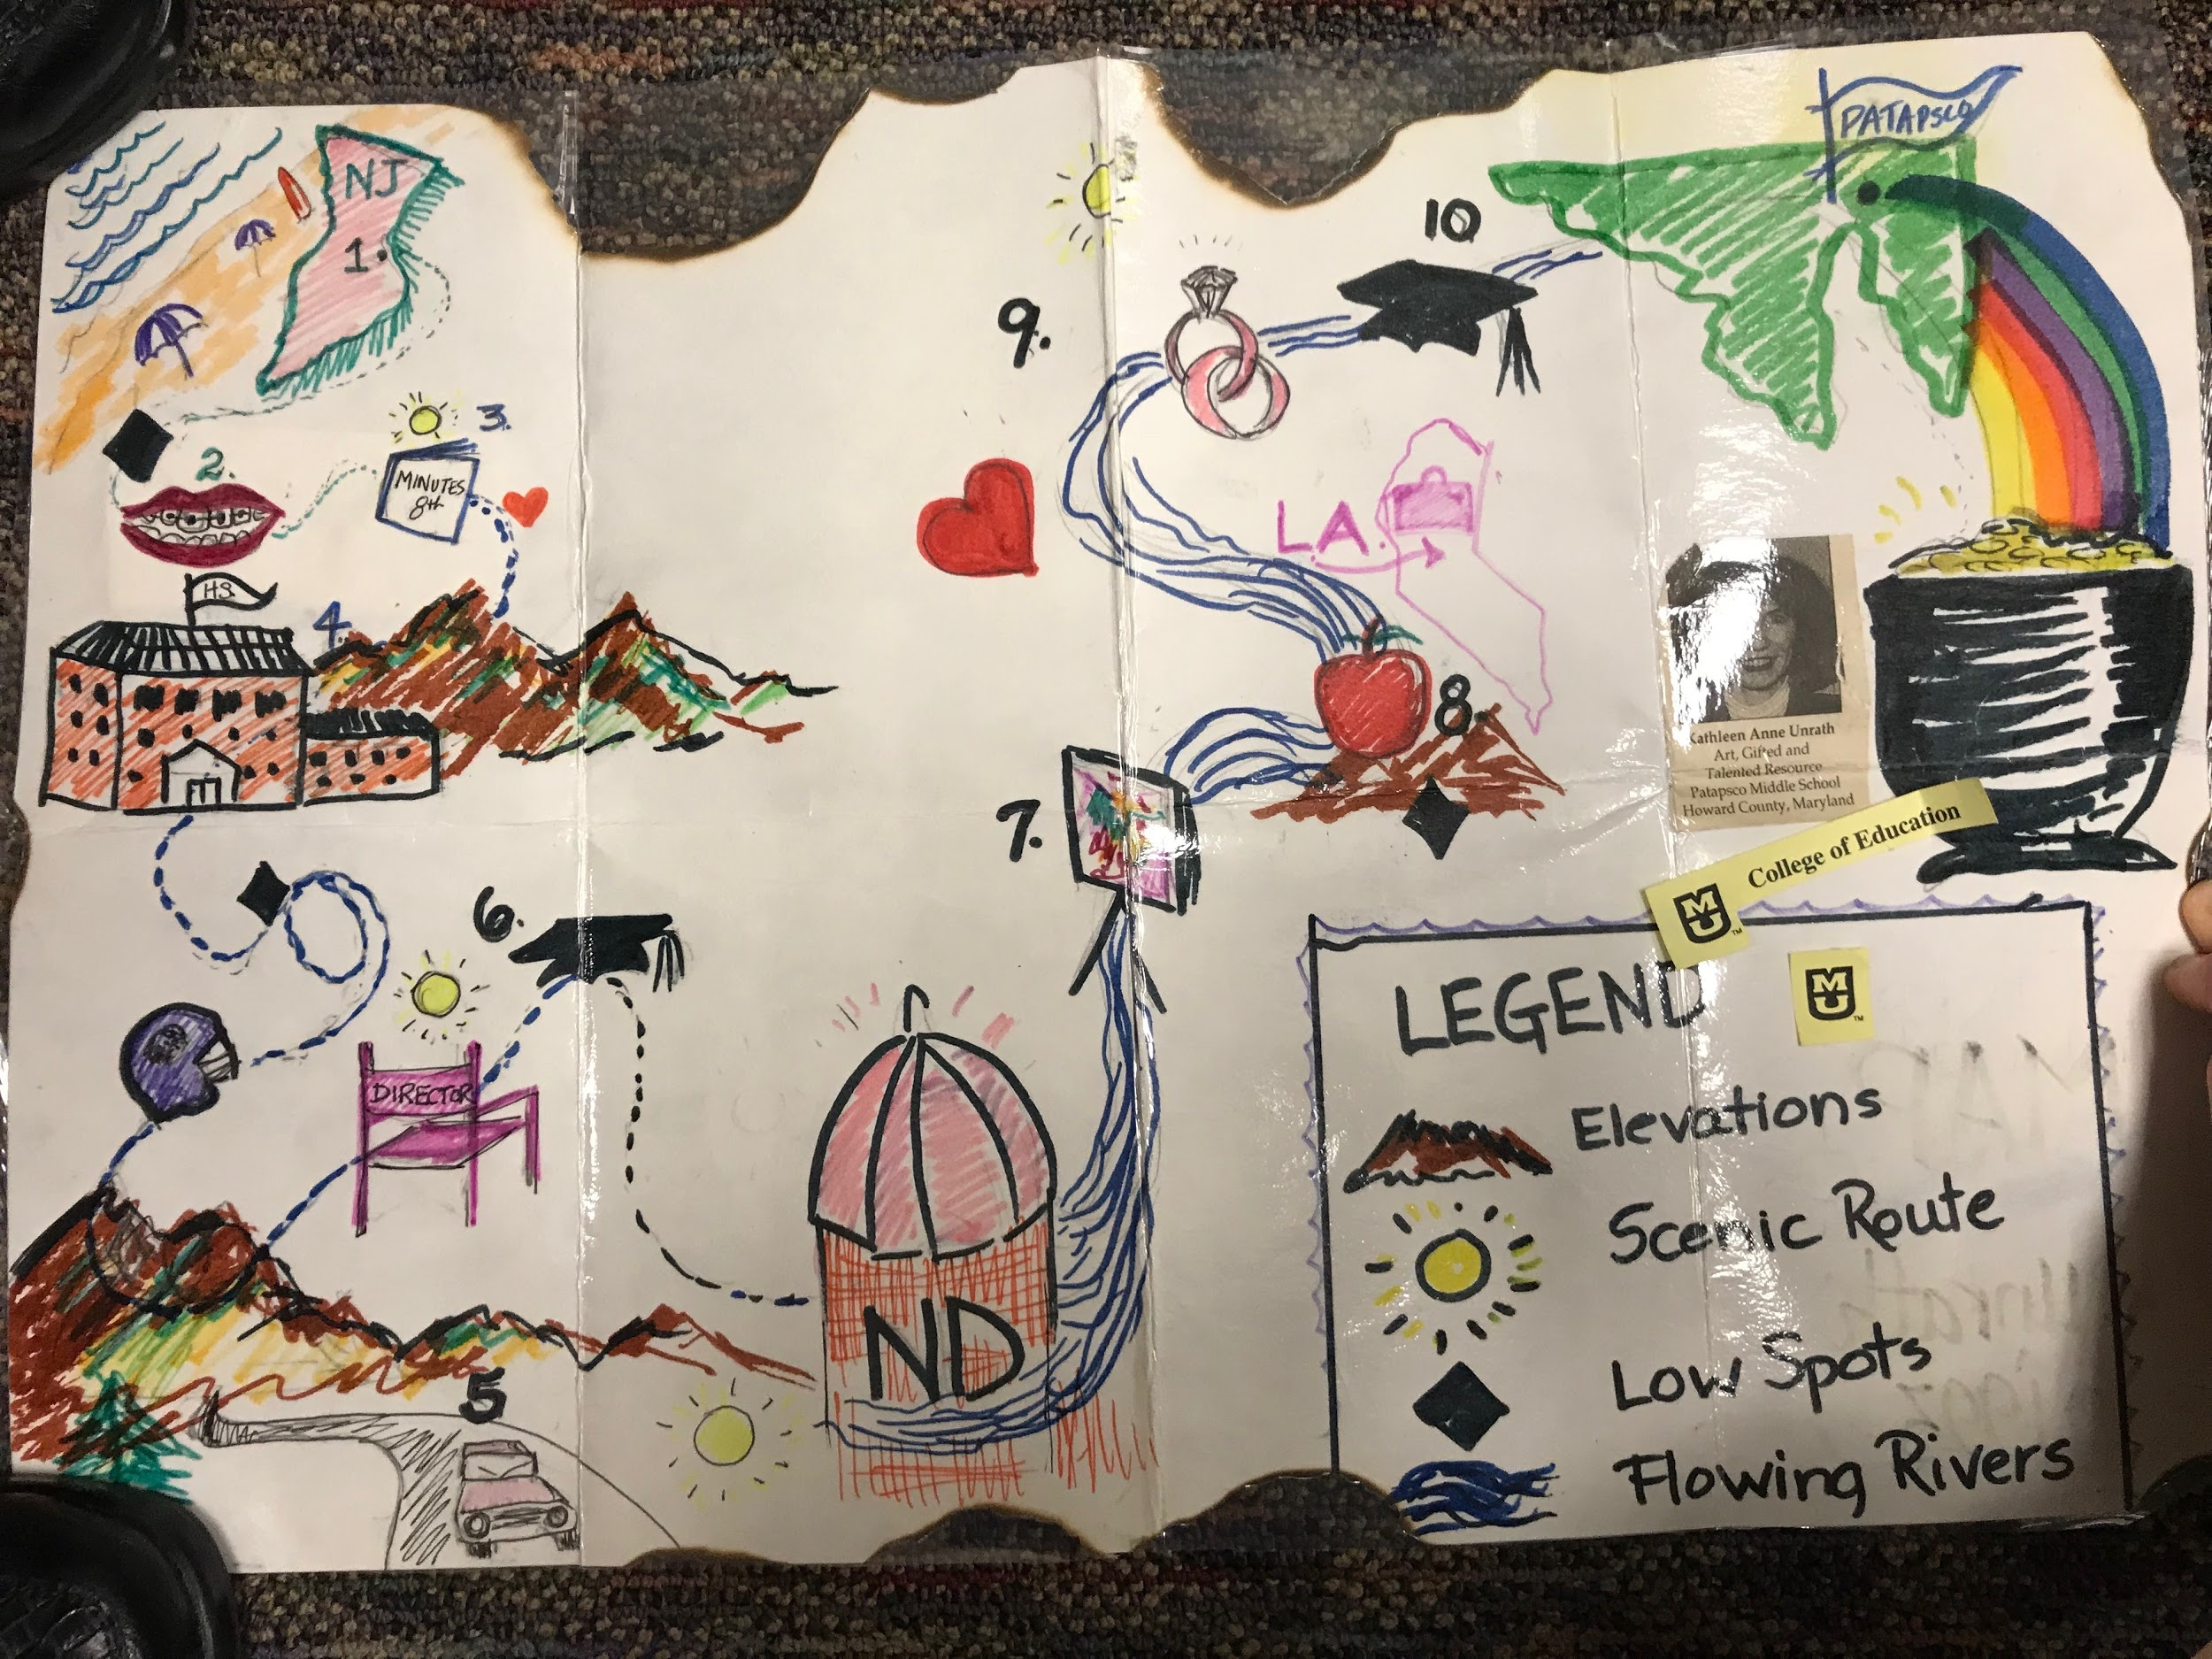
Artist/Researcher/Teacher: Dr. Unrath
Associate Professor
MU College of Education
Notes:
Guest speaker: Dr. Unrath

Slide 9
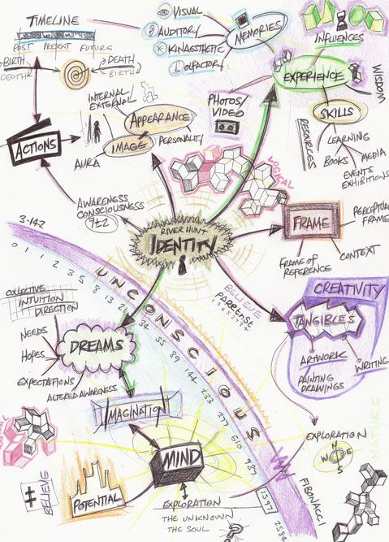
More....

Slide 10
Prompts
1. Where do you come from? Who are you?
2. What makes you grow up?
3. How do you get through hard time?
4. How do you link your past with the present day?
5. What is interesting about your journey?
6. What cultural tradition would you like to share with others in Columbia, Missouri?
Notes:
hand out the prompt sheet (See Appendix 2), and participants would get inspiration from it. Have students contemplate on those prompts. (5 minutes)

Slide 11
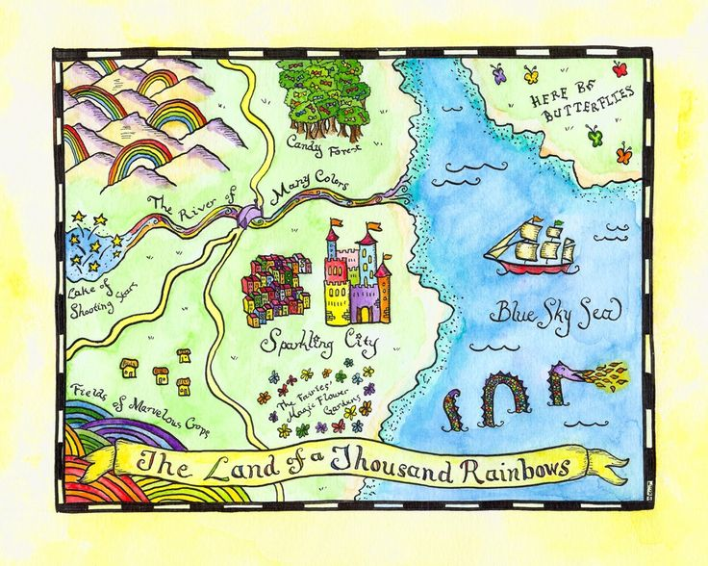
Artmaking Activity
You are going to make a map of journey, and it could be either drawing or collage. With the support of prompts, you can start to make your map. You have 30 minutes.

Slide 12
TIME’S UP

Slide 13
Observation and...
Hang your work up on the whiteboard.
View each other’s map and answer the question (take a note) from the observation sheet.
Notes:
Have students view each other’s map and take a note in the observation sheet (See Appendix 3). (5 minutes)

Slide 14
SHARE!!!
Notes:
Have participants share their maps and thoughts and the rest of them could examine whether their views are close to the presenters.

Slide 15
THANK YOU!

