Slide 1
By using
Show daydream
Techniques
Lesson 4 Technology

Slide 2


contents
1
2
3
4
5
Exploring Surrealism
Wei Li’s
artworks
Jenny’s example
Making videos
Art Show

Slide 3


1
Exploring
Surrealism

Slide 4

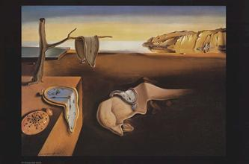
Exploring surrealism
Surrealism began in 1924.
Psychoanalyst Sigmund Freud wrote a book called The Interpretation of Dreams
Freud believed that there was a deep layer of the human mind when memory and our most basic instincts were stored
Ultimatism: painting was designed to reveal the unconscious mind.

Slide 5
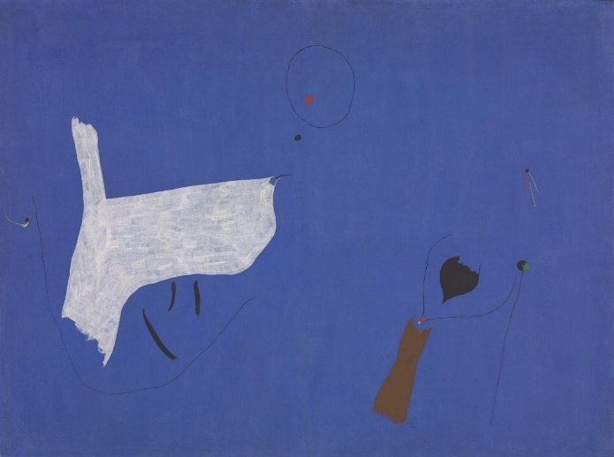
Salvador Dali
A
Lobster Telephone
John Muir
B
Muir liked to represent dreams with pure color. Shapes are arbitrary.
Surrealism
Sigmund Freud
Surrealism is not just an art movement; it is a way of thinking, a way of life - a way of transforming existence.
C
Freud spent his life deciphering the codes of the unconscious mind so that people could understand themselves better.

Slide 6
2
Wei Li’s
Artworks

Slide 7
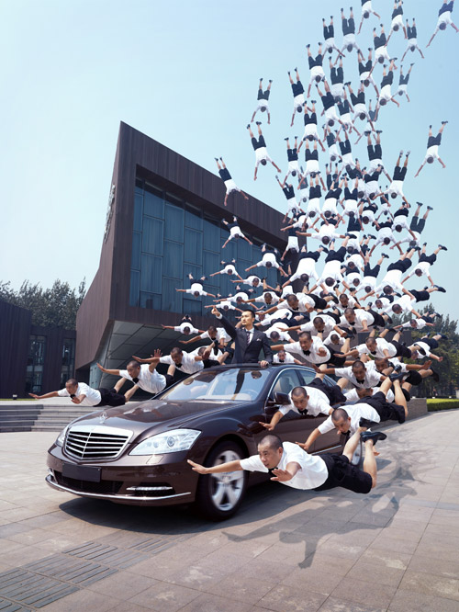
Wei Li
Wei Li (born in 1970, Hubei, China) is a contemporary artist from Beijing, China. His work often depicts him in apparently gravity-defying situations.

Slide 8
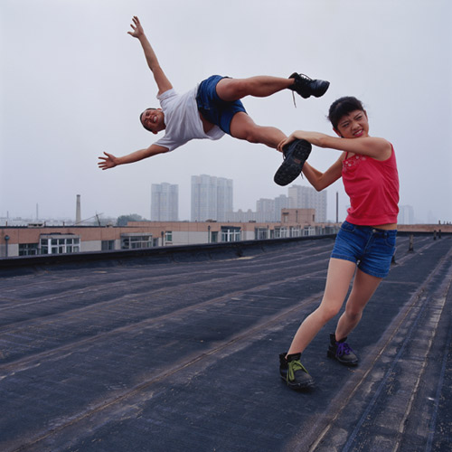

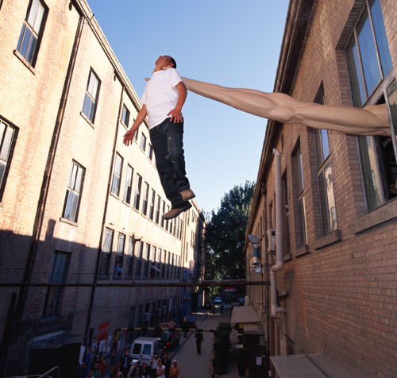

Slide 9
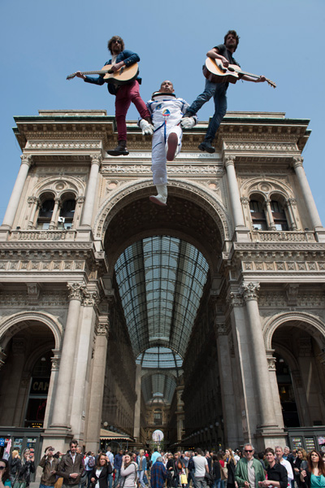
What is going on in this picture?
What do you see that makes you say that?
What more can we find?

Slide 10
3
Jenny’s Example

Slide 11
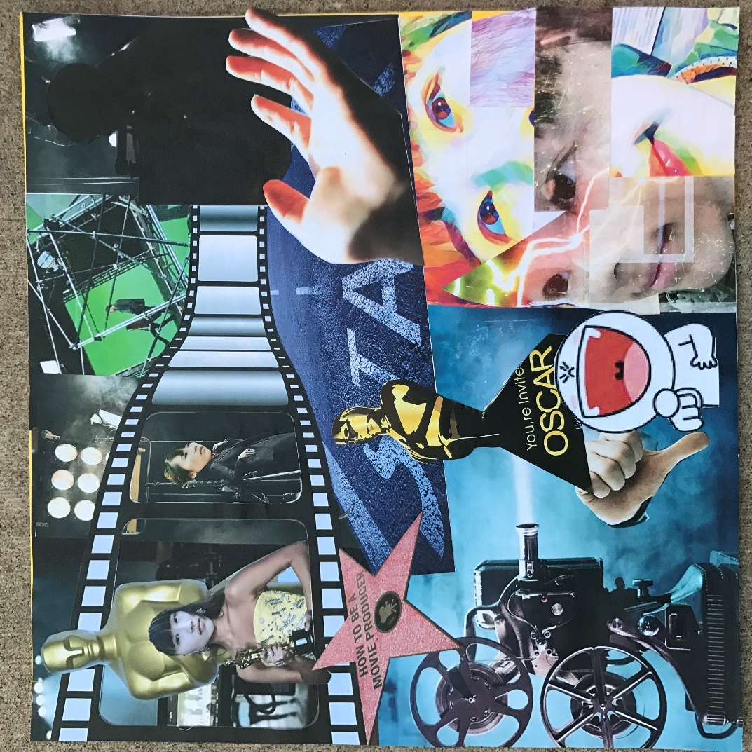
Documentation Video
Pictures: https://www.youtube.com/watch?v=XTbFSSi7stQ
Videos: https://www.youtube.com/watch?v=ot-LHYKk-1U

Slide 12
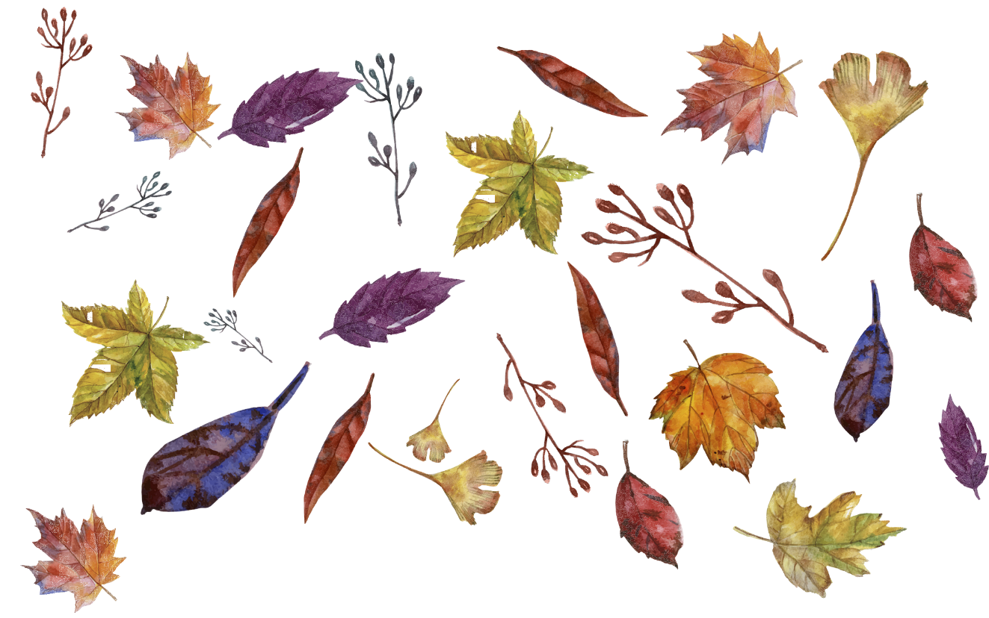
My thinking processes and working procedures
My artwork focuses on dreams for the future – to be a famous movie producer. Unfortunately, people usually have stereotypic notions of daydreams and aspirations because they don’t think that the daydreams will be realized in the future. However, I am not wrong when I am daydreaming about being a famous movie producer. Furthermore, I know it is time to take action to be a movie producer. If I believe I can make it happen, then I will make my dreams come true.
Since I am conscious of these thoughts, I proceed to choose footages that represent the ideas and concepts that I want people to realize.
I clipped and combined the footages in the sequence and reviewed the whole sequence several times. I then started to write the voice over according to the sequence.
After that, I used the iMovie app to record my voice and added it into the sequence. The length of voiceover should be matched with the length of sequence.
I then chose the songs that are closely linked to my daydream as the background music and generated the sequence into video.

Slide 13
4
Making Videos

Slide 14
A. Go over all footages or pictures you have filmed. Remember that the maximum time of the video is 2 minutes.
C.
Each footage should follow a consecutive order.
How to select footages or pictures that you have filmed?
D.
B.
Choosing the footages or pictures that show your thoughts, ideas or opinions. (Ask yourself: why do I choose this footage or picture?)
Each footage or picture should be presented clearly.

Slide 15

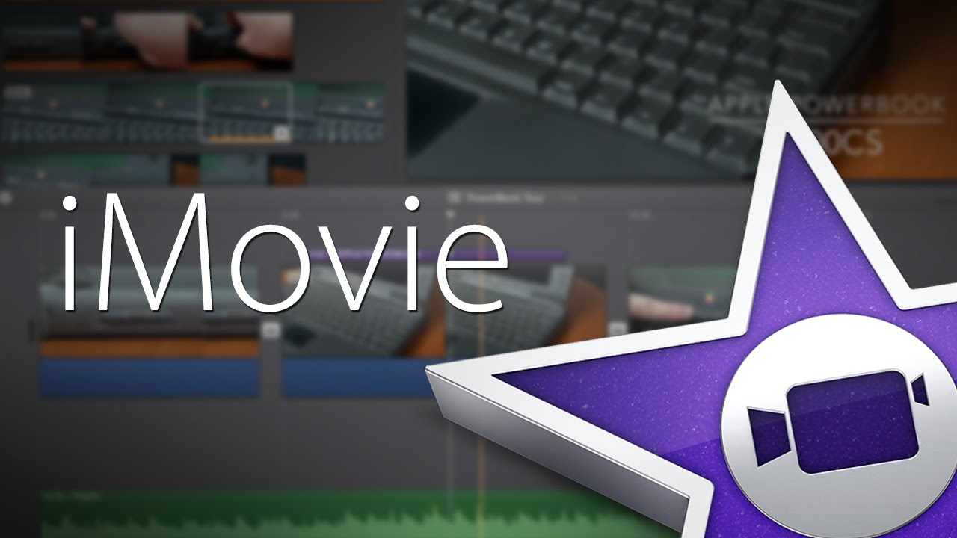
iMovie Tutorial
Open iMovie App
1
Click to create a new project
2
Add videos to the Timeline
3
4
Scrub through to see which frame you like most

Slide 16
iMovie Tutorial
If you want to start here :click and drag your circle to the starting point and and then circle where you want to end, then put it into your timeline view.
5
6
Repeat the same thing you did at step 5. However, you can also add still pictures by clicking the camera and going to camera roll and add the picture into the timeline. Remember to make the picture shorter.
7
If you do not like the footage, you can double click it and then delete it.

Slide 17
iMovie Tutorial
Think about the footages you combined in the timeline and make notes. Ask yourself: does each footage demonstrate your thinking process? Why do you present your artwork in this way?
8
Go over the timeline several times and write down the voice-over in terms of your thinking processes. However, if your footages already have voice-over, you can use them directly.
9
Record a voice-over: click record button and click the record again. You will see the countdown. Make sure that you are ready to record your voice. When you are done, click the red stop button. You can review it. If you like it, you can click accept. Or if you do not like it, you can delete it and then retake it.
10

Slide 18
iMovie Tutorial
Add music to timeline: pick the music to add to the timeline. (Ask yourself: what does your daydream sound like?)The green in timeline is the audio – music. Turn down the music if it is louder than your voice-over.
11
Add a title: title is available by double-clicking the video, and you will see title style. Pick the one you like. When you are done, you can go back and play the video
12
13
Use themes: you can click the gear in the top right-hand corner, and you can see themes. Pick the one you like. You may not need to use the theme song, if so turn it off.

Slide 19


Finish your video
One cool thing about the video is if you go to My Projects, you will then see the video you’ve created. You can rename it. Also you can play your video fullscreen by clicking the second button.
Click the third button and you can send your video out to your camera roll.
YAY

Slide 20

Open the YouTube App
Click the top button on the right
Click the video button, it will show the camera roll and then pick your video, clicking the next.
Type your title and description about your video.
When you are done at step 3, you can click the upload button.
When the video is uploaded, you should copy the URL link to Note Memos
Upload your video to YouTube

Slide 21

Open the QR Code Maker App
Click Add button on the right, and then add the code name (you can use your first name)
Copy the URL link that we formerly copied to this app.
Click the Generate button and save this QR code to your camera roll.
Open your Bluetooth and Airdrop, and then send your QR code picture to Mrs. Ruopp. She will help you print the QR code so that you can attach it to your artwork.
Generate the QR Code

Slide 22
5
Art
Show

Slide 23


Your artworks will be displayed in the classroom/hallway and each artwork is attached with a QR code.
You should stand by your artwork and share your ideas and thoughts to your parents, and reflect on your process of making artwork.
After that, you would also observe and contemplate others’ artworks. Remember to scan the QR code to watch others’ videos. These videos are also artworks.
ART
SHOW

