Slide 1
The Assessment Mechanism
Jenny (Ning Zhan)

Slide 2
What is a good journal page?
When I read the book, Assessment in Art Education in page 23, “Journal entries can be reviewed and assessed using different techniques such as checklists, rating scales, teacher, peer, parent, other interviews and student self-assessments (about the quality and progress).” Also, there are some criteria that could be for assessing art journals, such as content, development of ideas, and craftsmanship.

Slide 3
I think a good journal should……
Be titled every page.
Use color.
Use pen or marker for handwriting.
Reflect on experience.
Add decorative techniques.
Match text and drawing in a good way.
Have a good content related to the required task.
Demonstrate a progression
Be readable.
And so on……

Slide 4
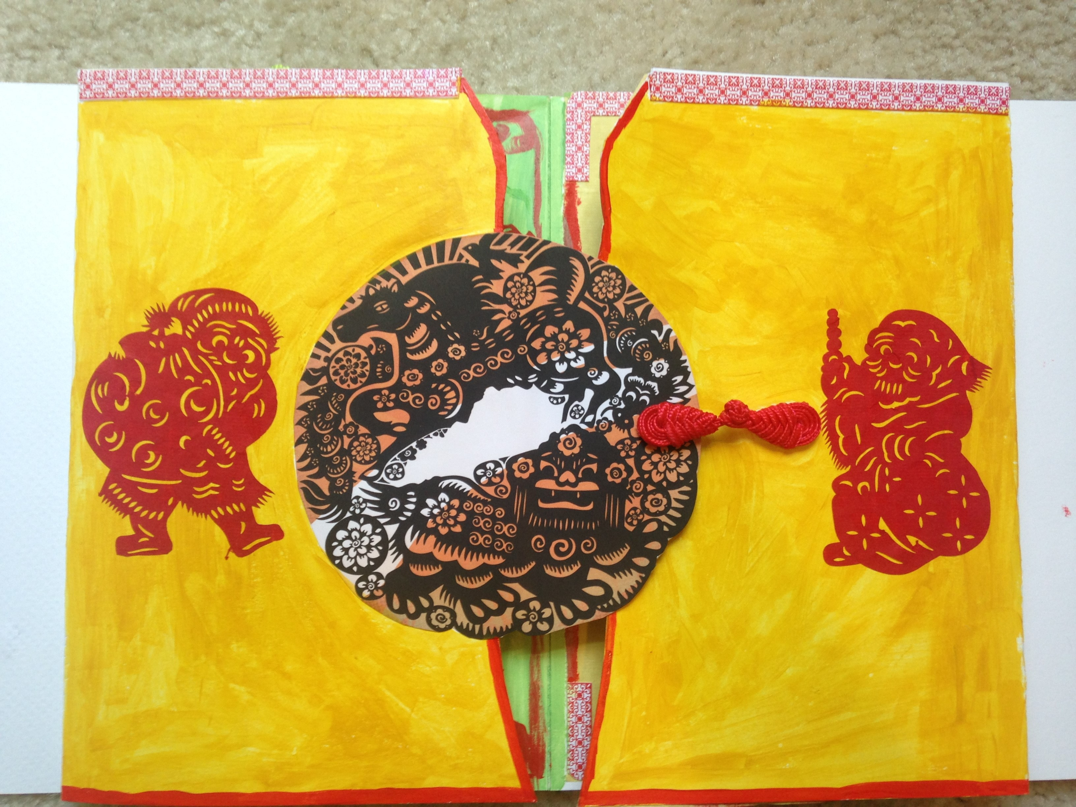
Example:
Use color

Slide 5
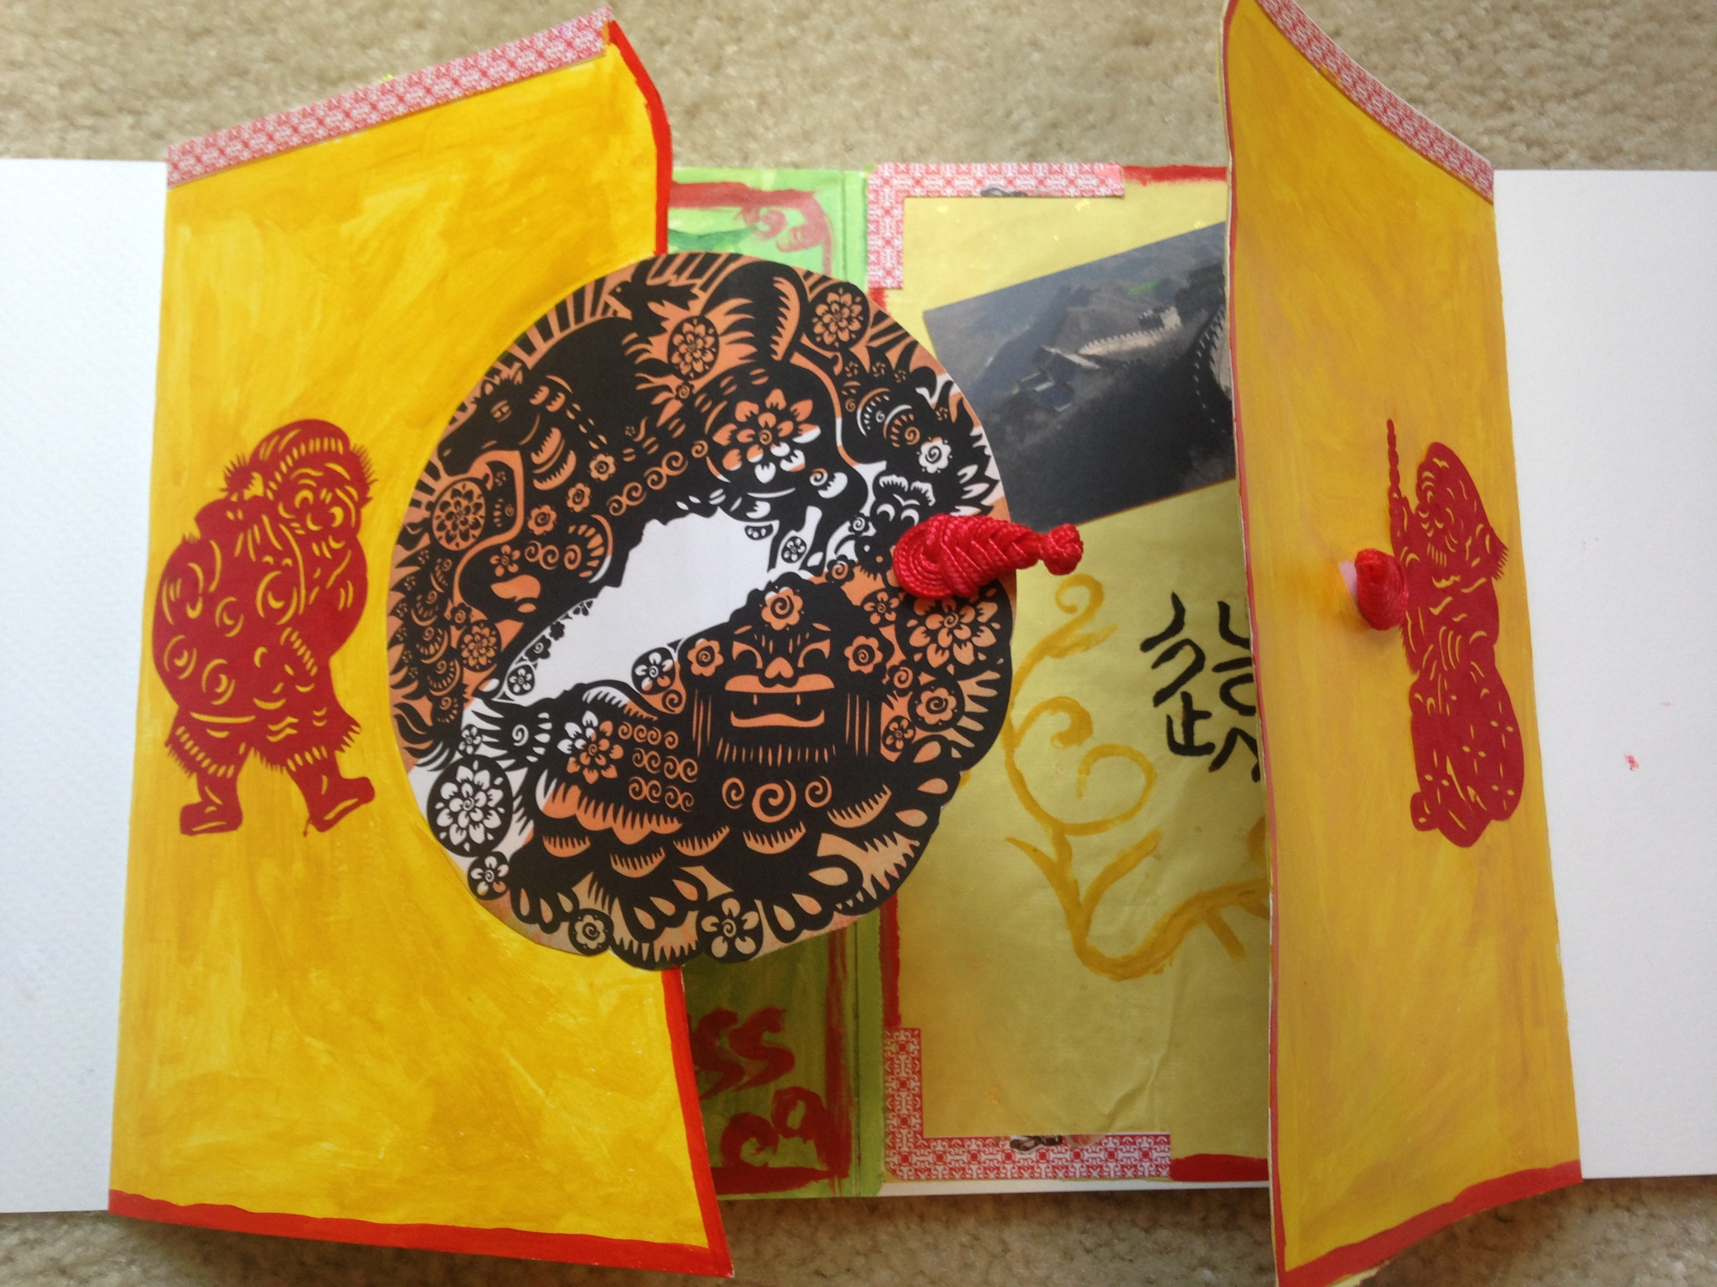
Create a new idea

Slide 6
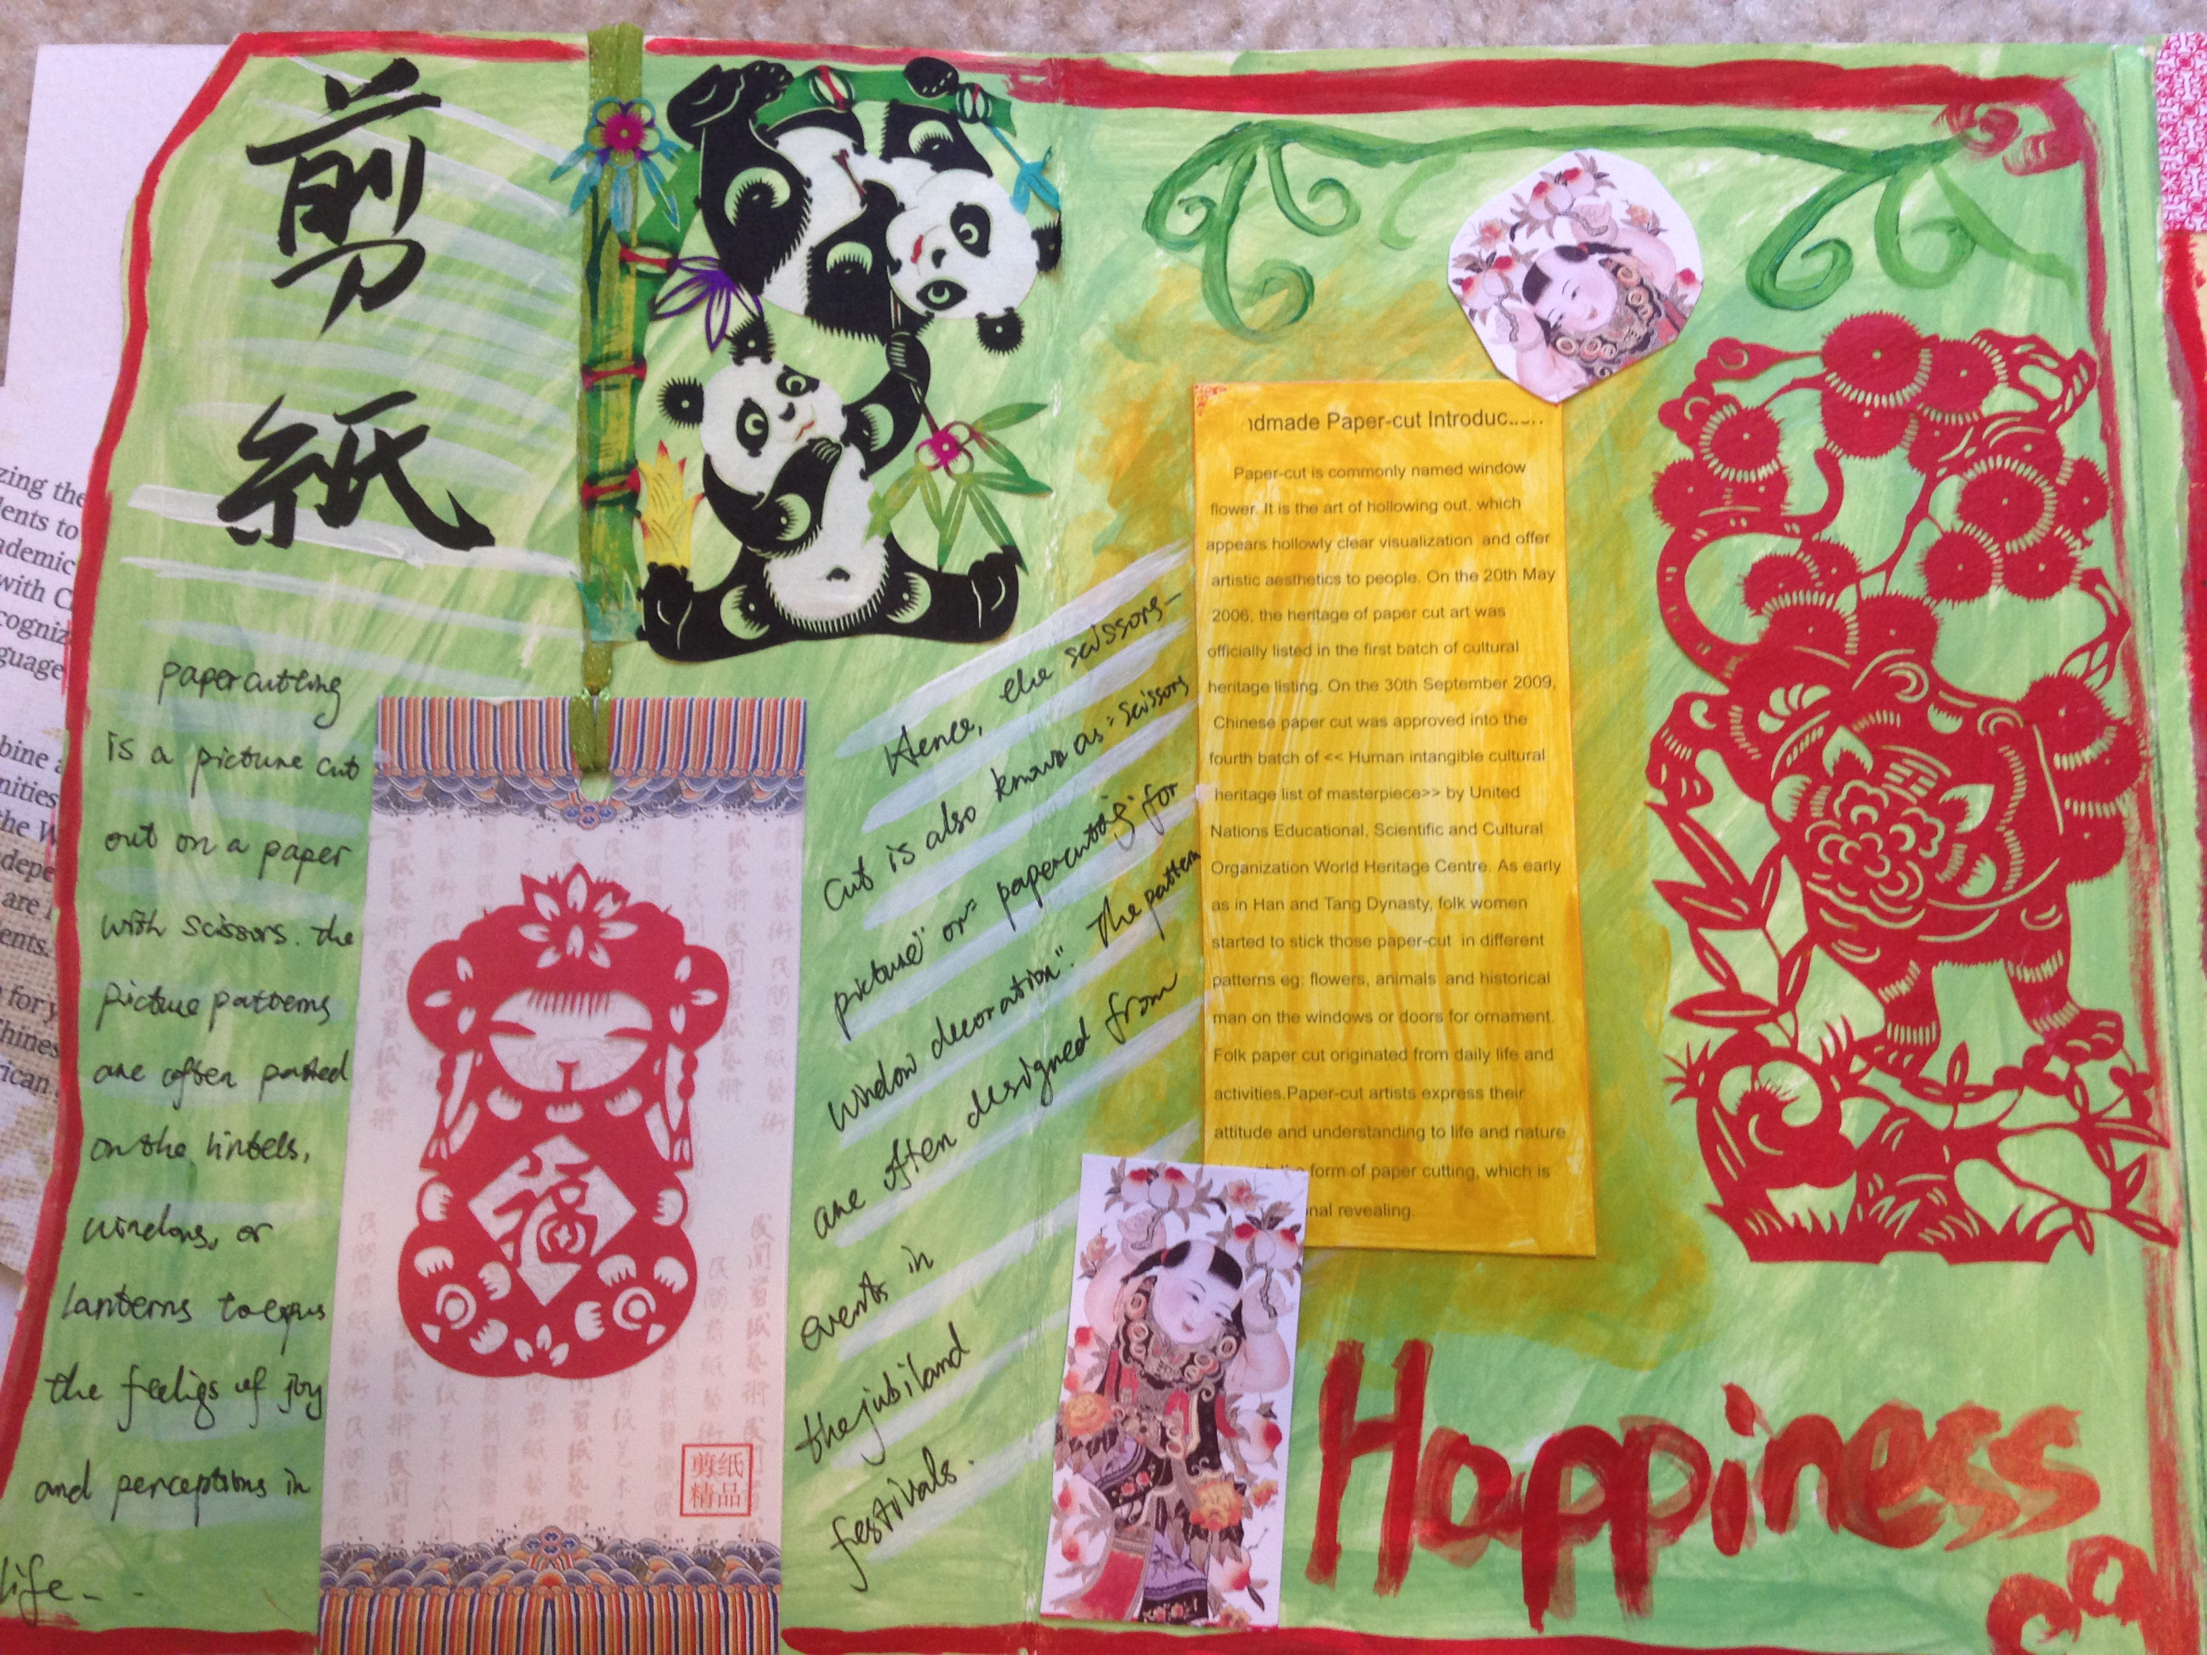
Be titled
Good content
Decorative techniques
Handwriting and be readable

Slide 7

Have your own meaning
Handwriting
Reflect on experience

Slide 8
Assessment mechanism
A good journal:
Be titled every page.
Use color.
Use pen or marker for handwriting.
Reflect on experience.
Add decorative techniques.
Match text and drawing in a good way.
Have a good content related to the required task.
Demonstrate a progression
Be readable.
An unsuccessful journal:
No title on page
Only use one color.
Only do simple drawings or handwriting
No personal experience
No decorative techniques.
The content does not relate to the required task.
Can’t read.

Slide 9
Art Grading Criterion
Explain what grads mean
Determine the meaning of failure
Incorporate performance variables
Determine grade distribution
Clarify grade components
Determine how grade components will be weighted
Determine standards
Plan for borderline cases.
----Page 109, Assessment in Art Education

Slide 10
Grading
Assignment: 40% of grade
Projects: 50 % of grade
Quizzes: 10% of grade
A = 90%-100%
B = 80%-89%
C = 70%-79%
D = 60%-69%
F = < 59%

